Slide 1


EASY DECLARATION SYSTEM

Slide 2
What is Declaration System?
It is a system designed to assist student to declare their electronic devices online
This will save time as items may be declared anywhere , at any time

Slide 3
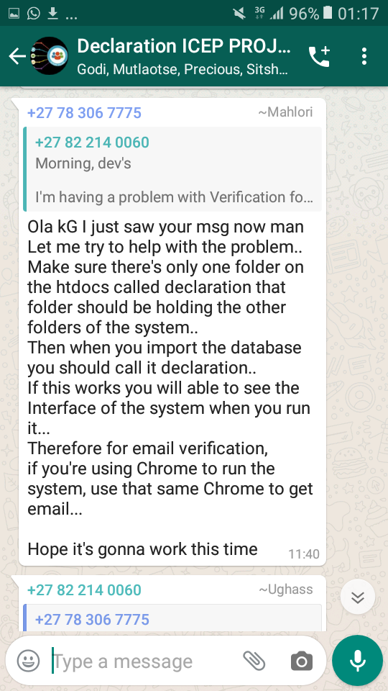
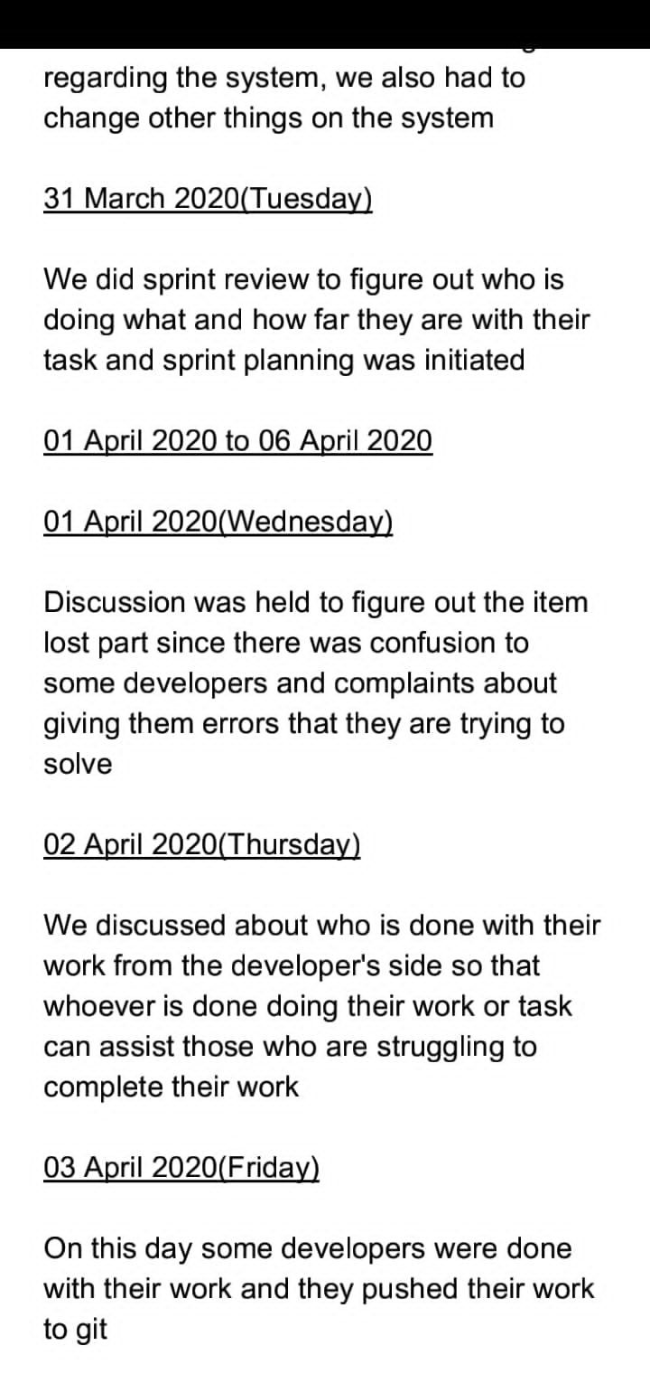
Methodology Used
Agile Methodology was used throughout developing the system
Scrum was used, which is the process of Agile that has sprints

Slide 4
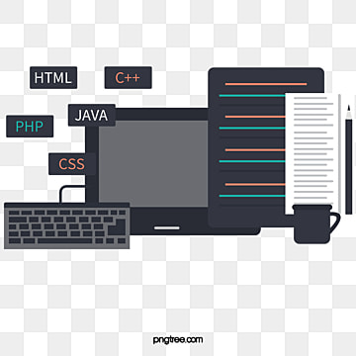
Technology Used to Develop Declaration System
JavaScript
HTML
CSS
PHP
Bootstrap 4
Microsoft Visio
Adobe XD
Postman

Slide 5
Functionalities of the System
Declare items
Upload proof of purchase
Alert messages
Perform CRUD
Print Proof of declaration
Count the number of items declared

Slide 6

Conclusion
We believe that Declaration system with make declaring electronic devices way much easier and safely so.

